Slide 1
DRIVER DROWSINESS DETECTION SYSTEM
Shri Shankaracharya Institute of Professional Management & Technology, Raipur
Minor Project Report on
CSE 7th Semester
Department of Computer Science and Engineering,
Batch 2018-2022
Session Jun – Dec 2021
Presentation Date: 11/12/2021
Project Group Members:
Aditi Tiwari (303302218112)
Apoorva Chourasia (303302218118)
Vaibhavi Pathak (303302218113)
Project Guide
Mr. Anand Tamrakar
(Assistant Professor, Computer Science Department)

Slide 2
Application Area
Driver drowsiness is one of the reasons for large number of road accidents these days. With the advancement in Computer Vision technologies, smart/intelligent cameras are developed to identify drowsiness in drivers, there by alerting drivers which in turn reduce accidents when they are in fatigue.
In this work, a new framework is proposed using deep learning to detect driver drowsiness based on Eye state while driving the vehicle. To detect the face and extract the eye region from the face images, Viola-Jones face detection algorithm is used in this work.
This system alerts driver with an alarm when the driver is in sleepy mood.

Slide 3
Project Overview
Driver fatigue is one of the three commonest causes of motor vehicle accidents and the effect of driver fatigue has been underestimated in the past due to difficulties in identifying fatigue as the cause of a crash. The problem of driver fatigue of course moves far beyond just road vehicles to all modes of transportation, being an important factor in rail, sea and air accidents as well. Driver fatigue commonly causes “fall asleep” motor vehicle accidents. These tend to be more severe or fatal compared with other road accidents. This is because they often involve a single vehicle running off the road at high speed, they tend to occur on higher speed roadways, and braking or other preventative measures may be absent. If truck drivers are involved, the potential to cause death or serious injury to other road users is greatly increased. It is commonly known that drowsiness and driving is not a good combination.

Slide 4
Software Requirements
Anaconda Editor
Web Browser
OpenCV
TensorFlow
Keras
Pygame
Python

Slide 5
Hardware Requirements
CPU: 2 x 64-bit 2.8 GHz 8.00 GT/s CPUs
RAM: 32 GB (or 16 GB of 1600 MHz DDR3 RAM)
Storage: 300 GB. (600 GB for air-gapped deployments.)
Additional space recommended if the repository will be used to store packages built by the customer.
With an empty repository, a base install requires 2 GB.
Display – Any compatible monitor
Connection – Internet Connection
A Working Web Cam

Slide 6
Back End Details
Model Architecture
The Dataset
CNN

Slide 7
Database Details
Tensor Flow
Keras

Slide 8
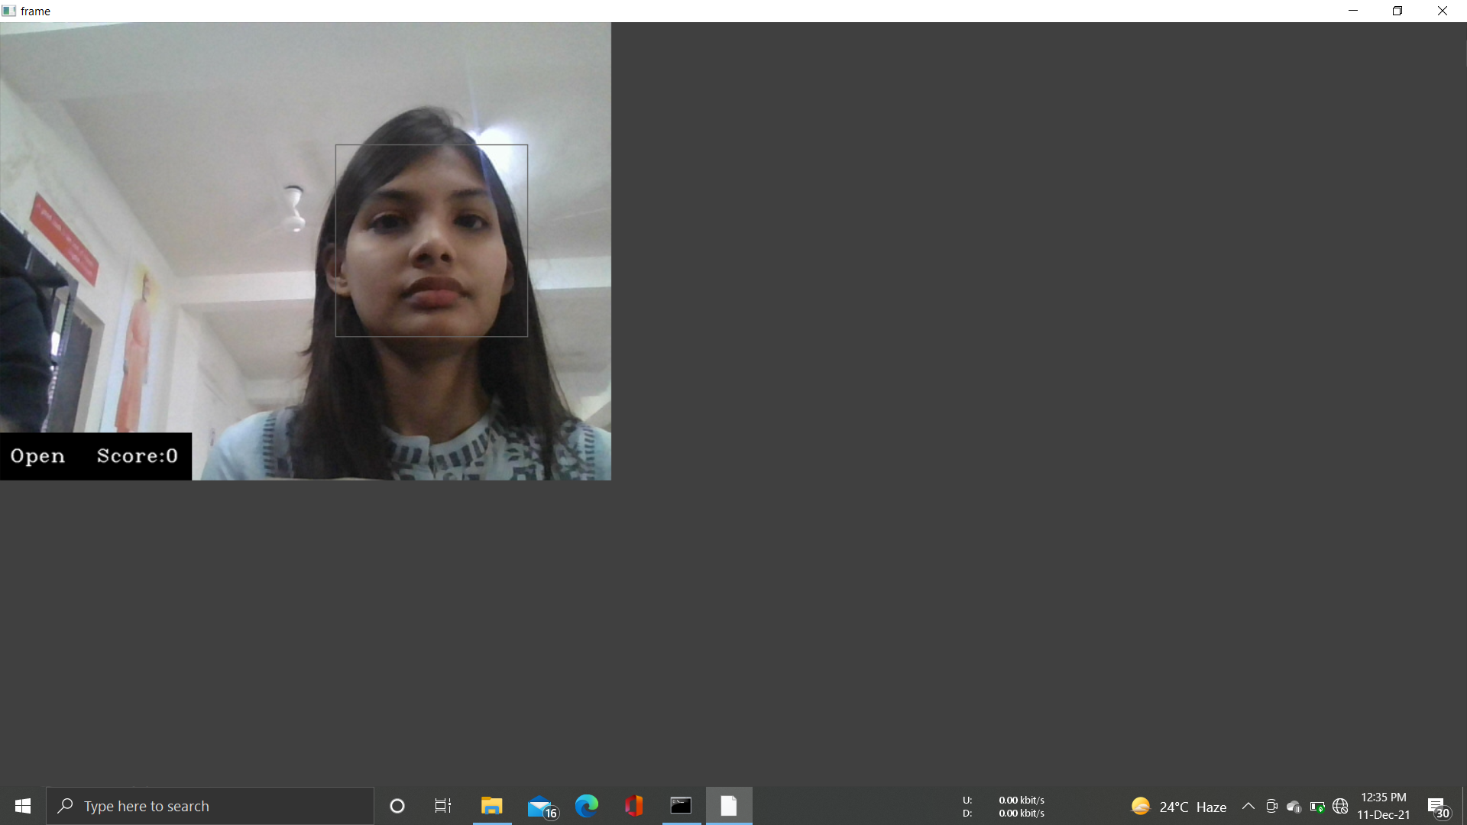
Front End Details
As it’s a console based application , our front-end look like this.

Slide 9
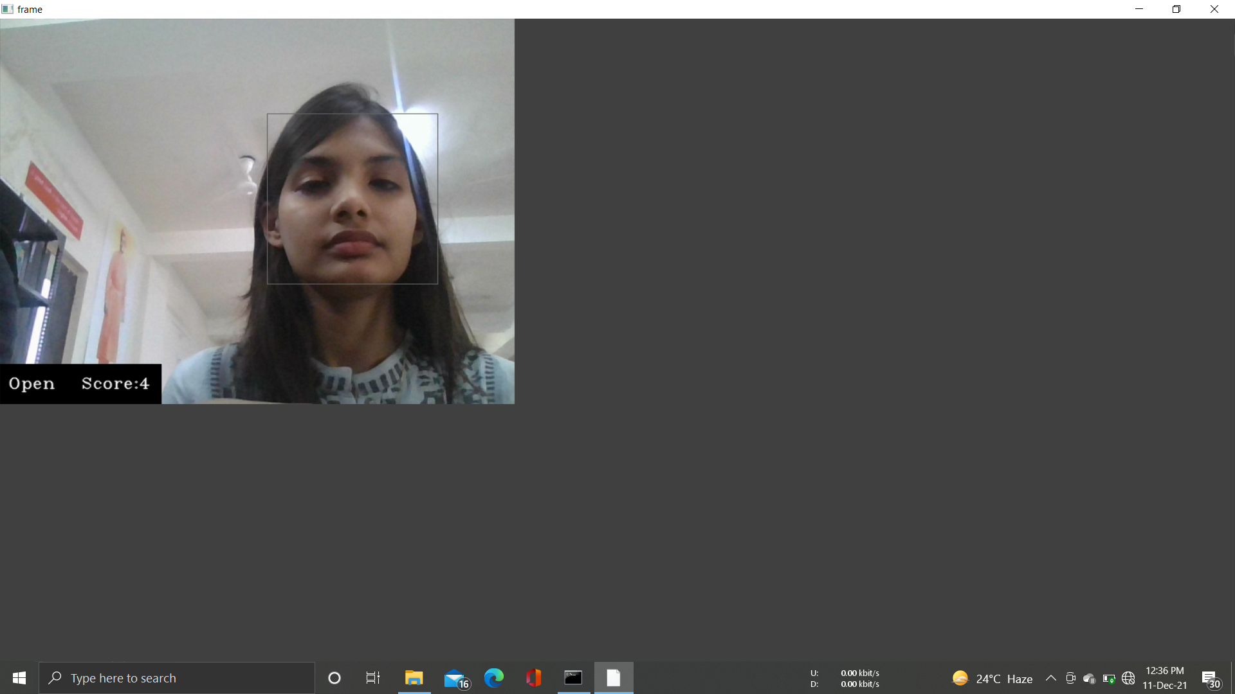

Slide 10


Slide 11
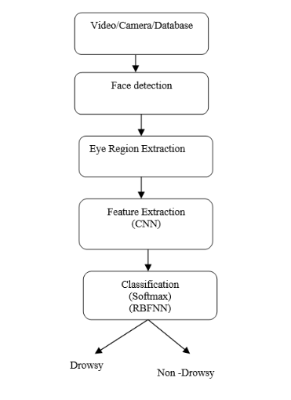
Project Flow Diagram

Slide 12
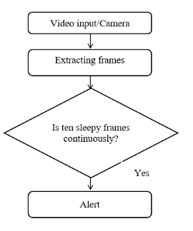
Data Flow Diagram

Slide 13
Result & Conclusion
In this proposed work a new method is proposed for driver drowsiness detection based on eye state. This determines the state of the eye that is drowsy or non-drowsy and alert with an alarm when state of the eye is drowsy. Face and eye region are detected using Viola-Jones detection algorithm. Stacked deep convolution neural network is developed to extract features and used for learning phase. A SoftMax layer in CNN classifier is used to classify the driver as sleep or non-sleep. Proposed system achieved 96.42% accuracy. Proposed system effectively identifies the state of driver and alert with an alarm when the model predicts drowsy output state continuously. In future we will use transfer learning to improve the performance of the system.

